Slide 1
COMP 7212: Operating/Distributed Systems
Chapter 8: Fault Tolerance
Dr. Myounggyu Won
“The goal is to construct a system in such a way that it can automatically recover from
partial failures without seriously affecting the overall performance.”
Reference: Distributed Systems: Principles and Paradigms (3rd Edition)

Slide 2
Introduction

Slide 3
Basic Concepts (1/3)
Fault tolerant system
  Availability
    A system that is ready to be used immediately
  Reliability
    A system that can run continuously without failure
  Safety
    A system that temporarily fails but operates correctly
  Maintainability
    A system that can be easily repairable

Slide 4
Basic Concepts (2/3)
A system is said to fail when it cannot meet its promises.
  e.g., services not provided.
An error is a part of a system’s state that may lead to a failure.
The cause of an error is called a fault.
For example, a crashed program is a failure which is caused by a programming bug (error). And the programmer is the fault of the error.

Slide 5
Basic Concepts (3/3)
Faults are classified as transient, intermittent, or permanent.
Transient faults occur once and disappear.
Intermittent faults occur, disappear, and then reappear.
A permanent fault continues to exist until the faulty component is replaced.

Slide 6
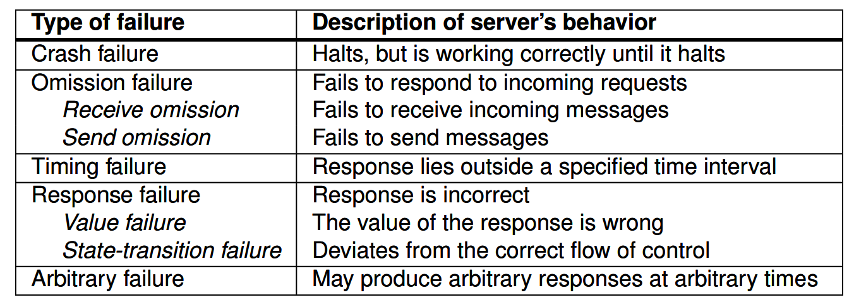
Failure Models (1/4)
Different types of failures
Also called as Byzantine failures.
Very hard to detect.
e.g., server receiving an
unexpected message.

Slide 7
Failure Models (2/4)
To better understand different types of failures, make a distinction between two types of distributed systems.
  Asynchronous system: no assumptions about process execution speed or message delivery time.
    Even if process P does not receive any action from process Q, it cannot conclude that process Q crashed.
  Synchronous system: process execution speed and message delivery time are bounded.
    When Q does not show any activity when it is expected to do so, P can conclude that Q has crashed.

Slide 8
Failure Models (3/4)
However, pure synchronous systems exist only in theory.
  e.g., even if process P does not receive an action from P within a certain bound, can we say that Q has really crashed?
It is more realistic to assume that a distributed system is partially synchronous.
  We can normally use timeouts to conclude that a process indeed has crashed, but that occasionally such a conclusion is false.

Slide 9
Failure Models (4/4)
In this context (i.e., assuming a system is partially synchronous), crash failures can be further classified as follows.
Fail-stop failures: crash failures that can be reliably detected.
Fail-noisy failures: crash failures that will eventually be detected.
Fail-silent failures: process P cannot distinguish crash failures from omission failures.
  i.e., is it failed or is it just not responding?
Fail-safe failures: arbitrary failures but they do no harm.
  Automatically results in a condition that minimizes or prevents harm or damage.
Fail-arbitrary failures: failures are unobservable and are harmful.

Slide 10
Failure Masking by Redundancy
A key technique for masking faults is to use redundancy.
Three different kinds of redundancy
  Information redundancy
    e.g., extra bits are added to allow recovery from garbled bits.
  Time redundancy: an action is performed again.
  Physical redundancy: extra equipment or processes are added to tolerate loss of malfunctioning.

Slide 11


Slide 12
Process Resilience
“Discuss mechanisms for protecting against process failures which is achieved by
replicating processes into groups.”

Slide 13
Resilience by Process Groups (1/3)
A key approach to tolerating a faulty process is to organize several identical processes into a group.
  A message is received by all processes in the group.
  If one process fails, some other process can take over for it.
Process groups may be dynamic.
  New groups can be created, and old groups can be destroyed.
  A process can join/leave a group.
  A process can be a member of several groups
  Therefore, a mechanism is needed to manage groups and group membership.

Slide 14
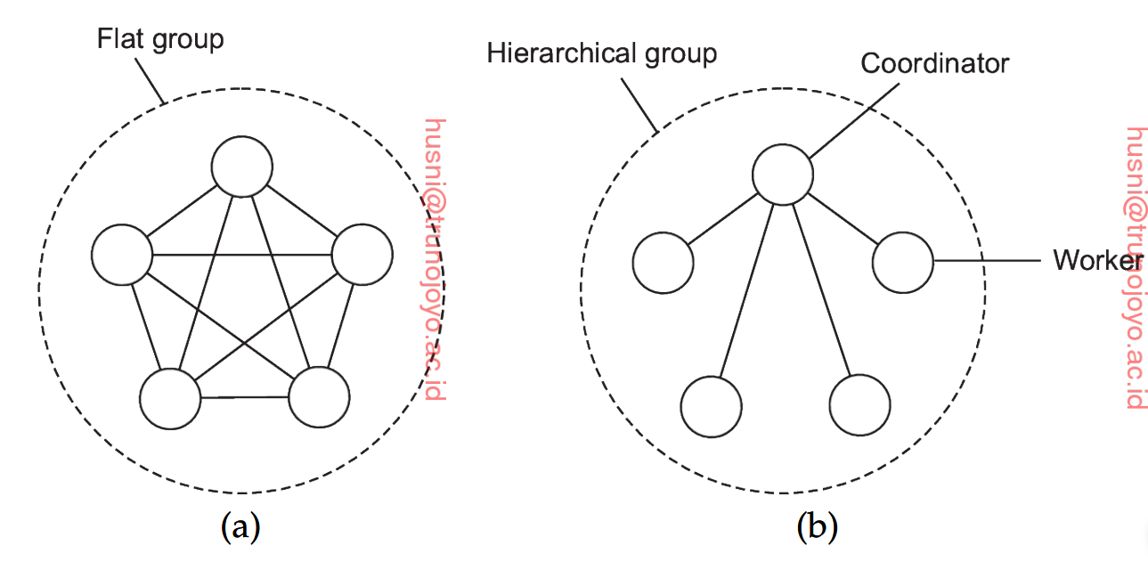
Resilience by Process Groups (2/3)
Group Organization
Different groups may have different internal structures.
  Flat group: all processes are equal.
    Pros: no single point of failure
    Cons: decision making is more complicated (e.g., a vote has to be taken)
  Hierarchical group: some kind of hierarchy exists among processes.
    Pros: easy decision making by the coordinator.
    Cons: loss of the coordinator may lead to a halt of the entire group

Slide 15
Resilience by Process Groups (3/3)
Membership Management
Some method for creating and deleting groups, and allowing processes to join and leave is needed.
One approach is to have a group server to which all these requests are sent. A group server maintains a complete database of groups and their membership.
  Easy to manage, but a single point of failure problem.
An alternative approach is to manage group membership in a distributed way.
  When a node joins/leaves, it sends a message to all other group members.
  Issues
    Leaving and joining have to be synchronous with data messages.
      i.e., as soon as a process has joined (left), it should receive (not receive) all messages sent to the group.

Slide 16
Performing Write Operation
Primary-based replication
  A group of processes are organized in a hierarchical fashion; a primary (coordinator) coordinates all write operations.
Replicated-write protocols
  Identical processes are organized into a flat group.
  All processes should coordinate to approve a write operation.

Slide 17
Degree of Replication
An important question is how much replication is needed (i.e., how many identical processes in a group)
A system is said to be k-fault tolerant if it can survive faults in k components.
  Thus, having k+1 processes is enough to achieve k-fault tolerance.
    if k processes fail (fail-stop failures), the answer from the last one left can be used
  However, when processes exhibit arbitrary failures, i.e., continuing to run when faulty, and sending out erroneous or random replies, 2k+1 processes are needed to achieve k-fault tolerance.
    k+1 correct components are needed to outvote k components producing faulty results

Slide 18
Consensus in Faulty Systems with Crash Failures (1/7)
Recall that clients send requests to a group of processes that act as a single, highly robust process.
To make this work, an important assumption is needed.
  In a fault-tolerant process group, each nonfaulty process executes the same requests, in the same order, as every other nonfaulty process.
This means that processes in the group need to reach consensus in terms of the order of executing requests/commands.
Recall that, to mask k faulty processes with fail-stop failures, k+1 components are needed.
  However, this is not the case for consensus!
  More difficult problem: how to achieve consensus in a systems with k faulty processes.

Slide 19
Consensus in Faulty Systems with Crash Failures (2/7)
Assume a group of processes P={P₁, …, P_{n}} operating under fail-stop failure semantics.
  Fail-stop failures: crash failures that make the system completely stop, which can be reliably detected.
Flooding consensus
  Step 1: Propagation of proposals
    At the beginning of each round, every process P_{i} broadcasts its current list of commands to every other process in the system.
    This list includes all the commands that P_{i} has received proposals for, up to that point, from itself or other processes.

Slide 20
Consensus in Faulty Systems with Crash Failures (3/7)
Flooding consensus cont.
  Step 2: Merging and Deterministic Selection
    Once a process receives the lists of proposed commands from other processes, it merges these lists into its existing list.
      Merging is done deterministically using the same method by all processes.
      This means every process uses the same rules or logic to order or select commands.
        This could be based on a timestamp (e.g., logical clock value) or any method that ensures consistency across all processes.

Slide 21
Consensus in Faulty Systems with Crash Failures (4/7)
Flooding consensus cont.
  Step 3: Command Execution (Decision Making)
    After merging, each process then deterministically selects a command (or all commands) from the merged list to execute.
    The selection criteria must be consistent across all processes to ensure that every process executes the same sequence of commands.

Slide 22
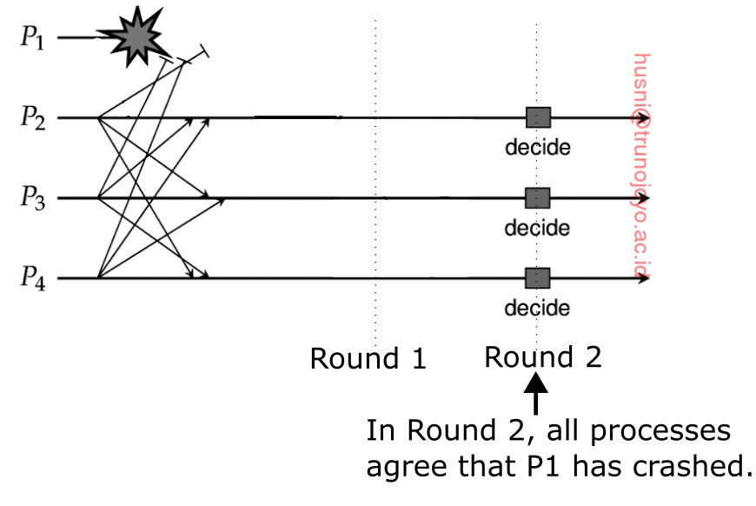
Consensus in Faulty Systems with Crash Failures (5/7)
Flooding consensus: an example with failures
  If a failure is detected before a decision is made, processes can reach a consensus based on the remaining non-faulty processes.
(Decision Postponed)

Slide 23
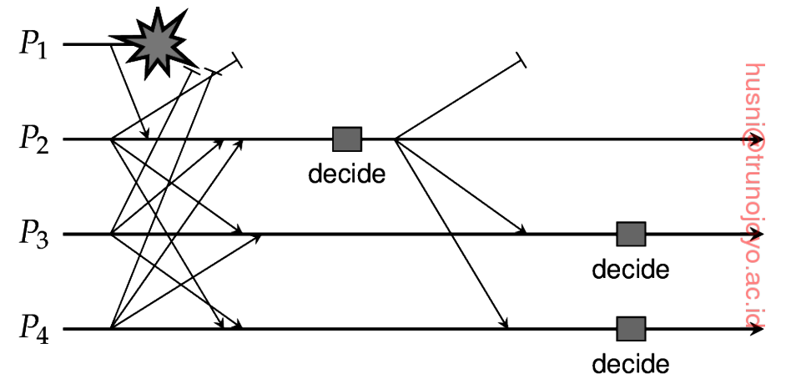
Consensus in Faulty Systems with Crash Failures (6/7)
Flooding consensus: an example with failures
  However, what if a process P_{i} detects the crash of P_{k} after a decision is made?
  For example, consider P={P1,…,P4} and assume that P1 has crashed. An interesting thing is that P2 has already received a list from P1 before P1 crashes while others (i.e., P3 and P4) did not.

Slide 24
Consensus in Faulty Systems with Crash Failures (7/7)
Flooding consensus cont.
  P2 is ready to make a decision since it has received the list from all processes.
  However, not for P3 and P4; they make a decision in the next round based since they did not receive the list from P1.
  In the next round, P3 and P4 and make a decision using the same merged list as P2 (which made the decision in the previous round) sent its list including the P1’s list.
    Basically, in this case as well, we need one additional round to make a decision
    Therefore, if we consider the worst-case scenario where one process fails in each round, we need total of k additional rounds, i.e., k+1 rounds are needed to make a decision.

Slide 25
Consensus in Faulty Systems with Arbitrary Failures (1/4)
How to reach consensus in a fault-tolerant process group in which k members can fail assuming arbitrary failures.
  Show that we need at least 3k+1 members to reach consensus under these failure assumptions.
Consider a processing group consisting of n members, of which one has been designated to be the primary, P, and the remaining n-1 to be the backups, B₁, …, B_{n-1}.

Slide 26
Consensus in Faulty Systems with Arbitrary Failures (2/4)
Assumptions
  A client sends a value v ∈ {T,F} to the primary, where v stands for either true or false.
  Messages may be lost, but this can be detected.
  Messages cannot be corrupted without that being detected.
  A receiver of a message can reliably detect its sender.
Requirements
  If the primary is non-faulty, then every non-faulty backup process stores exactly what the primary had sent.
  If the primary is faulty, every non-faulty backup process stores the same value.

Slide 27
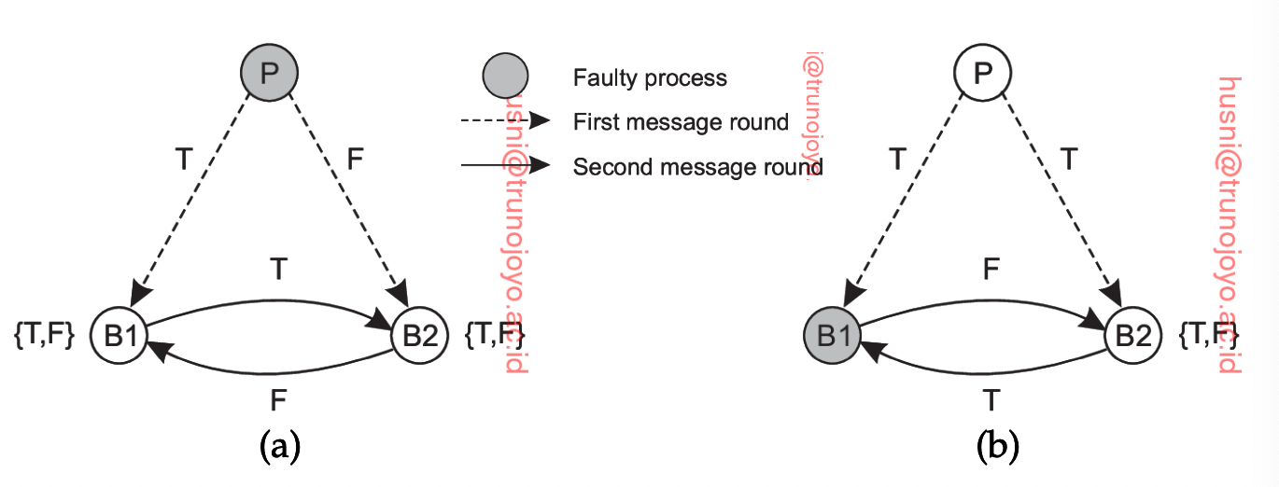
Consensus in Faulty Systems with Arbitrary Failures (3/4)
Why having 3k processes is not enough
  Prove with a counter example; Let us consider the situation in which we want to tolerate the failure of a single process, i.e., k=1.
    Two cases: the primary is faulty, or a backup is faulty
      Both cases do not lead to consensus.
    Therefore, 3k processes are not enough.
Primary is faulty
Backup is faulty

Slide 28
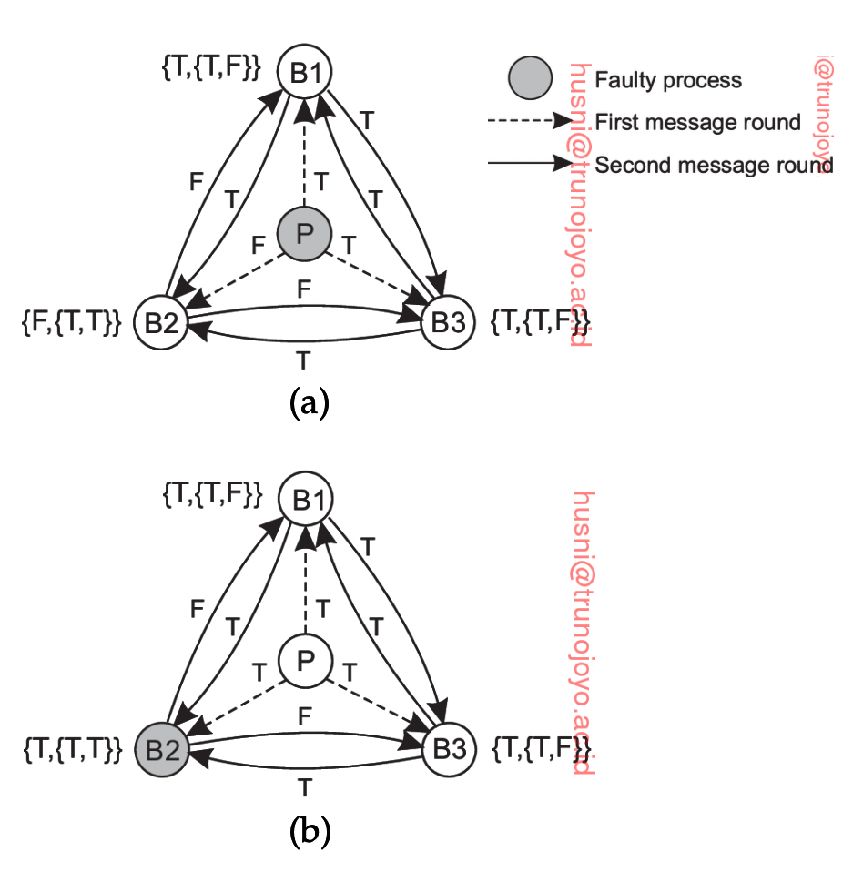
Consensus in Faulty Systems with Arbitrary Failures (4/4)
Why having 3k+1 processes is enough
  Consider the situation in which n=4 and k=1.
  (a) If the primary is faulty, no matter what it sends to backup nodes, the backup nodes reach consensus.
  (b) despite the failure of B2, B1 and B3 store exactly what the primary stores.

Slide 29
Written Assignment #3
Prove the correctness of the consensus algorithm for k (k >= 0) byzantine faults.
  Hint. Note 8.6 and 8.7 in the textbook.

Slide 30
Reliable Client-Server Communication
“Let’s discuss communication failures.”

Slide 31
Point-to-Point Communication
Reliable point-to-point communication is established by making use of a reliable transport protocol (e.g., TCP)
However, crash failures of connections are not masked.
  The only way is to let the distributed system attempt to automatically set up a new connection (i.e., by resending a connection request).

Slide 32
RPC (1/4)
Consider five different classes of failures
  The client is unable to locate the server.
  The request message from the client to the server is lost.
  The server crashes after receiving a request.
  The reply message from the server to the client is lost.
  The client crashes after sending a request.

Slide 33
RPC (2/4)
(1) Client cannot locate the server
  e.g., all servers are down, or clients running a different version of software.
  One possible solution is to raise an exception.
    Drawbacks: not every language has exceptions or signals; having to write an exception destroys the transparency (i.e., exposing the internal communication to clients).

Slide 34
RPC (3/4)
(2) Lost request messages
  A solution is to start a timer when sending a request; if the timer expires before an ack is received, resend the request.
(3) Server crashes
  The first possible solution is to wait until the server reboots and try the operation again.
  The second solution is to give up immediately and report back failures.
  The third one is to guarantee nothing, i.e., the client gets no help or promises about what happened.

Slide 35
RPC (4/4)
(4) Lost reply messages
  A solution is to reply on a timer again.
    A drawback is that the client does not know why there was no answer.
(5) Client crashes
  After a client sends a request, it crashes. The client is called an orphan (computation).
  A possible solution
    Orphan extermination: before a client stub sends an RPC message, it makes a log entry. So, when the client crashes, it can check the log and resume.
      Drawback is the cost to write log on disk.

